Slide 1
RocketC
Embedded Systems
C Compiler for VeSPA

Slide 2
Agenda
Frontend
Design / Implementation
Lexical analysis
Syntactic analysis
Semantic analysis
Middle-end
Design / Implementation
High-level optimizations
Backend
Design / Implementation
Code Generation
Low-level optimizations
Assembler
Verification
Lexical analysis
Syntactic analysis
Semantic analysis
High-level optimizations
Code generation
Low-level optimizations
Assembler
VeSPA Emulator

Slide 3
FRONTEND

Slide 4
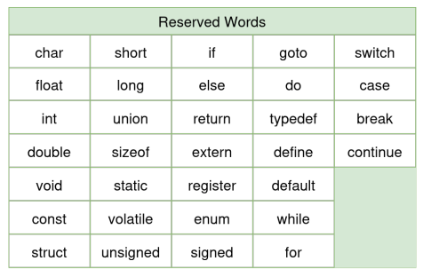
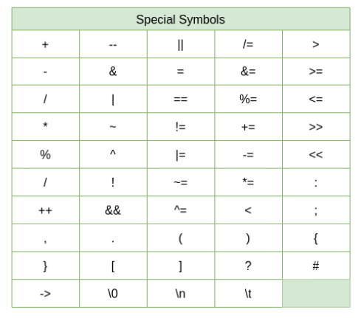
Lexical analysis
Keywords reserved by the C programming language syntax.
These words can not be used to define user specific parameters, as they are used to represent language specific operations.
Special symbols defined by the C programming language syntax

Slide 5
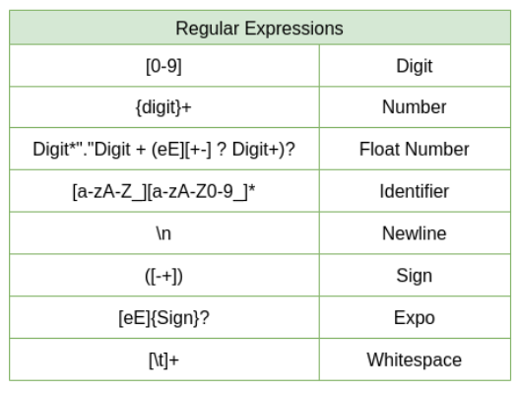
Lexical analysis
Regular expressions are patterns used to match character combinations in
strings. They define search patterns, crucial for identifying token types, facilitating accurate lexical analysis in compilation processes.

Slide 6
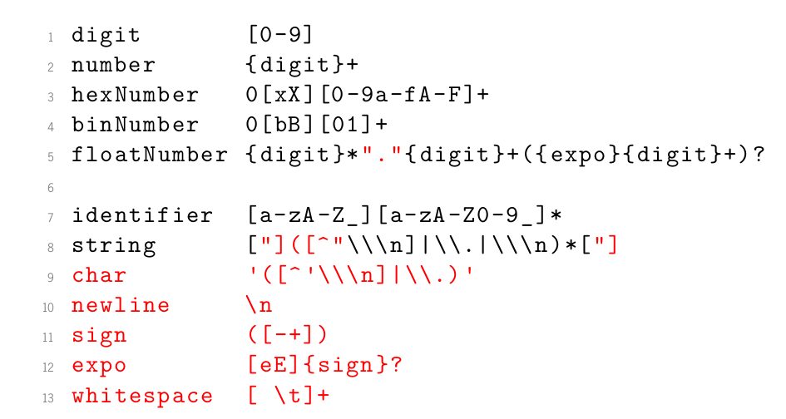
Lexical analysis
Definitions
Define how to parse the input character stream.

Slide 7
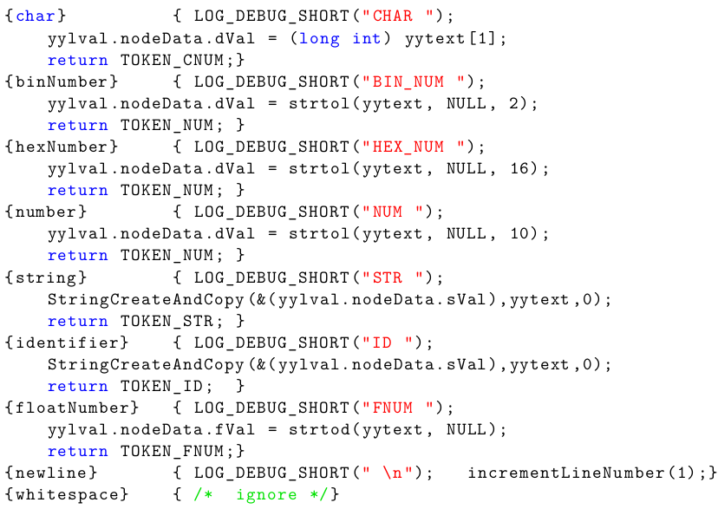
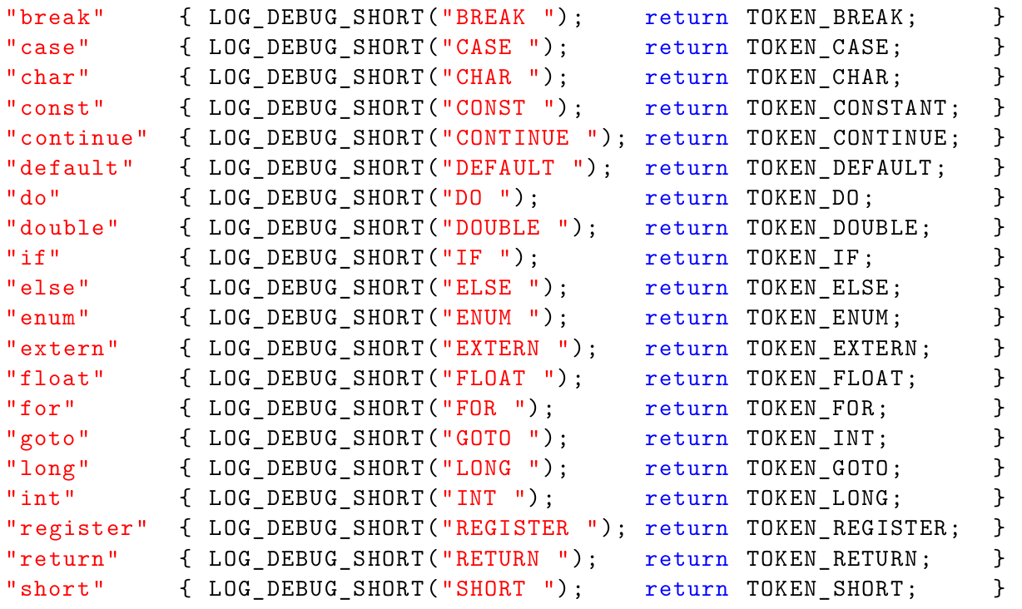
Lexical analysis
Rules

Slide 8
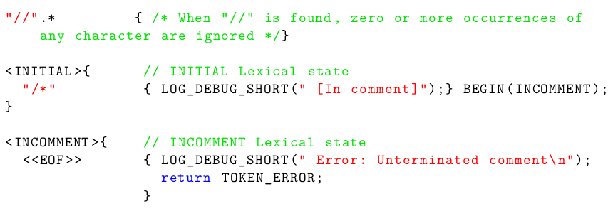
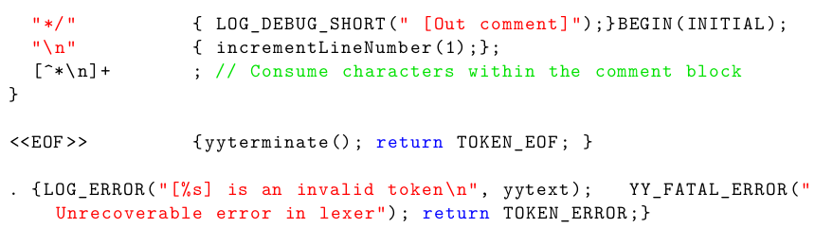
Lexical analysis
INITIAL state: The lexer is ready to recognize the usual token patterns.
INCOMMENT state: The lexer is within a comment block, handles EOF conditions, marks an error if the comment isn’t closed.
Upon encountering “*/” transitions back to INITIAL state.
Additionally, it consumes newline characters and characters within the comment block. Upon encountering the end of the file («EOF»), it terminates the lexer.
Rules

Slide 9
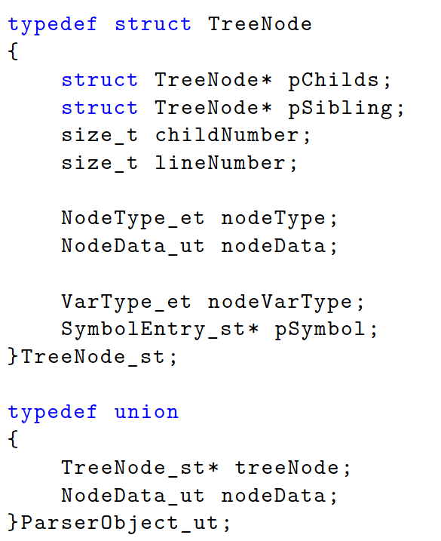
Syntactic analysis
AST Node Structure

Slide 10
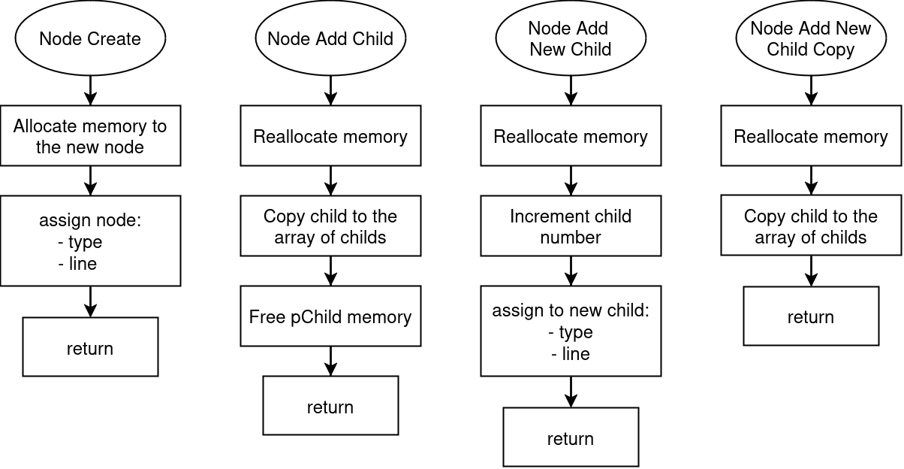
Syntactic analysis
AST Creation Methods

Slide 11
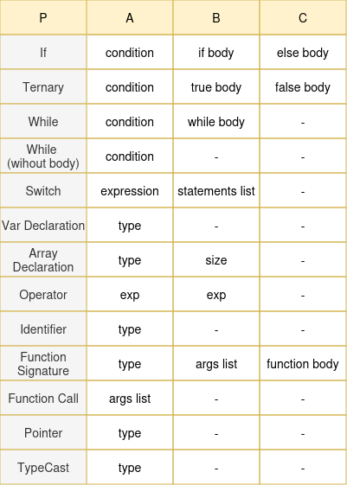
Syntactic analysis
AST Structure

Slide 12
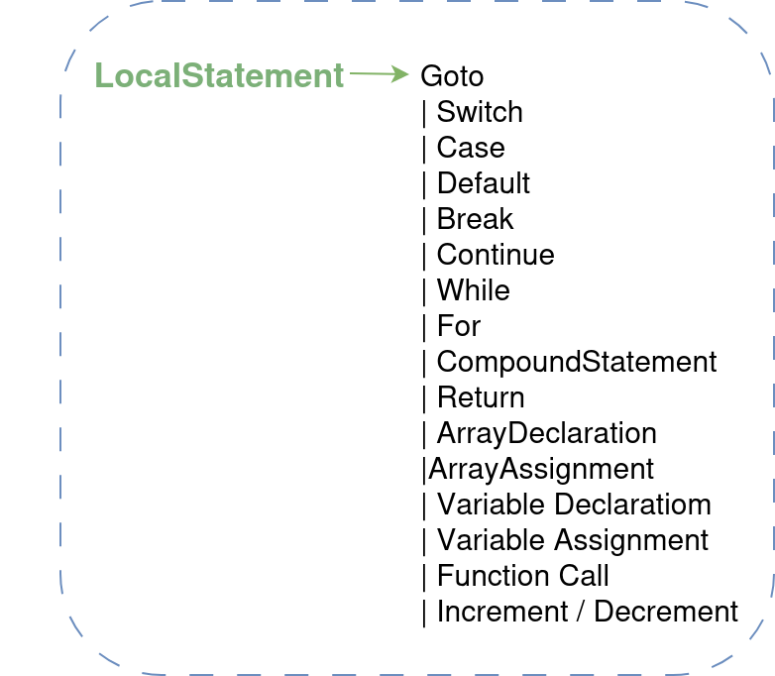
Syntactic analysis
Rule Structure Example

Slide 13
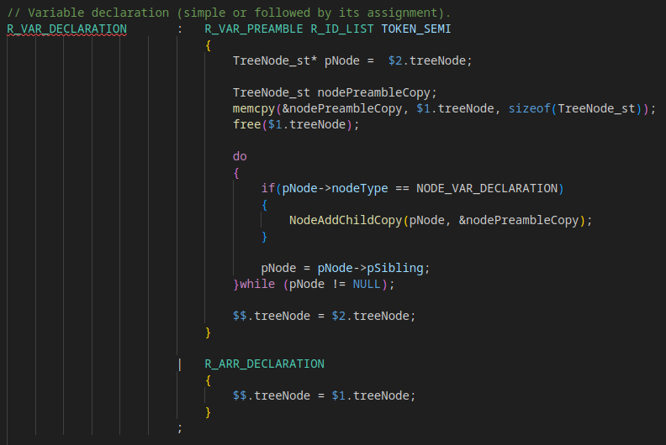
Syntactic analysis
Rule example

Slide 14
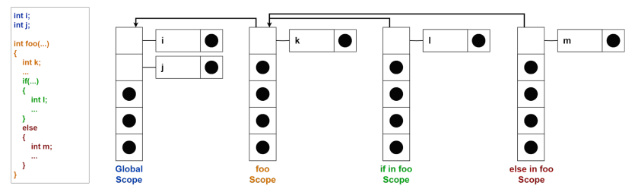
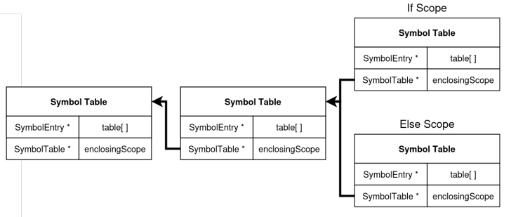
Semantic analysis
Scoped symbol table representation:

Slide 15
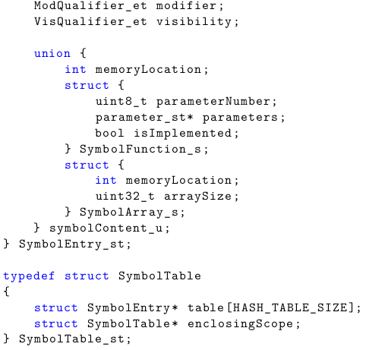
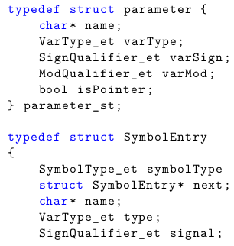
Semantic analysis
Symbol table structure:
Each instance of the SymbolEntry structure represents a symbol in the symbol table.
For an array symbol, it includes both the memory offset and the array size.
The parameter structure is used to represent the parameters of a function, storing information about
each parameter

Slide 16
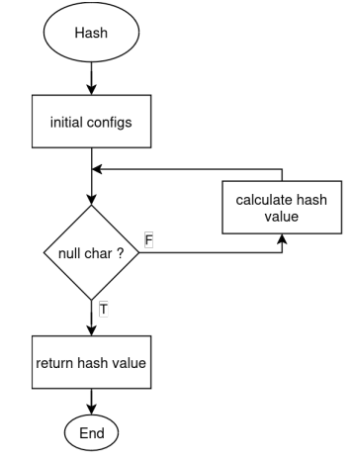
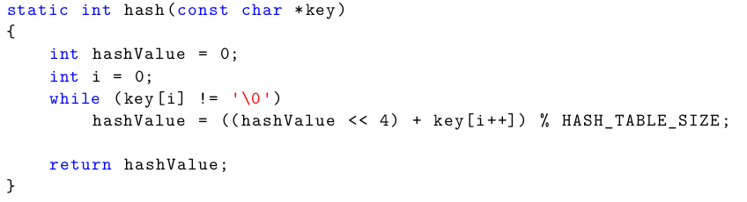
Semantic analysis
Hash function:

Slide 17
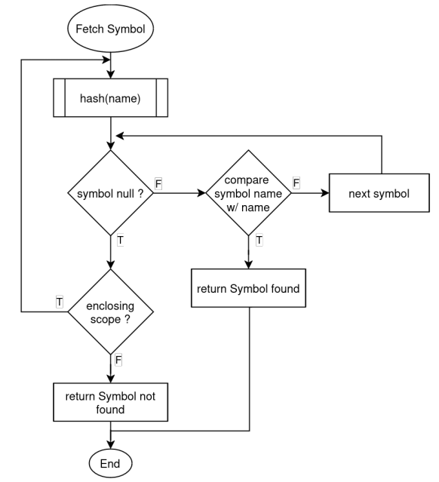
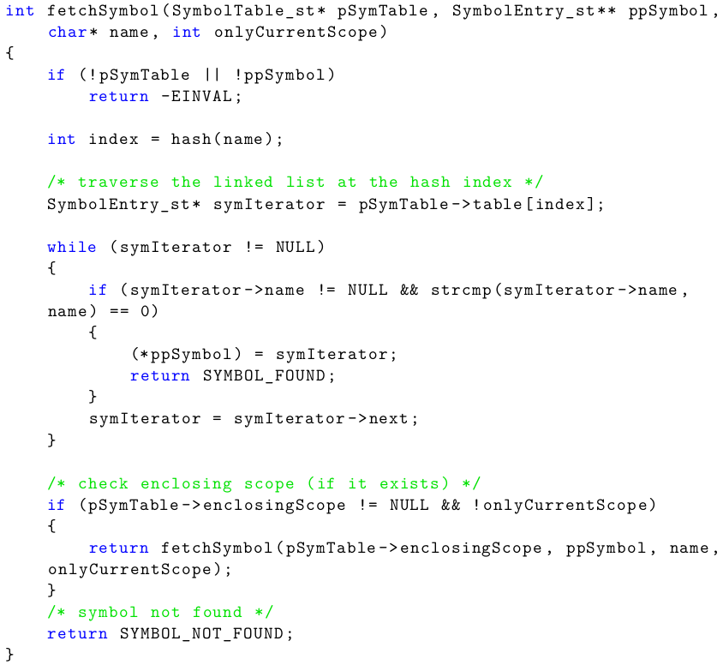
Semantic analysis
Fetch Symbol

Slide 18
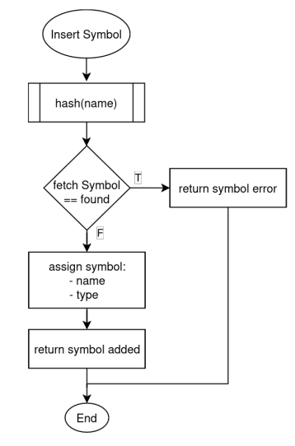
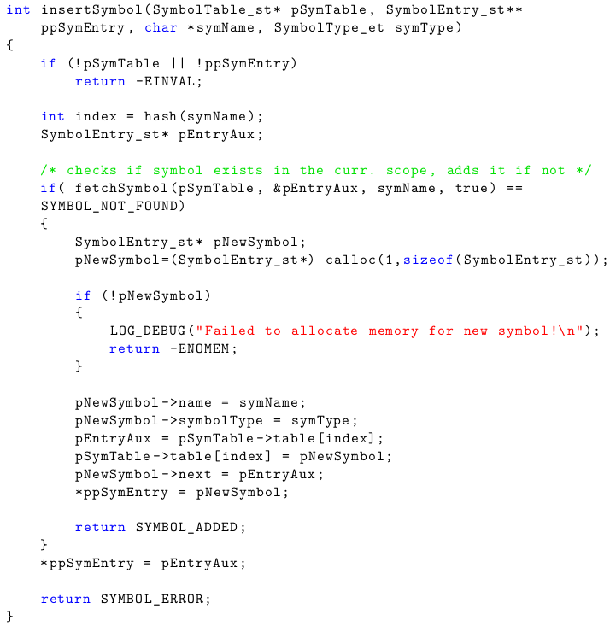
Semantic analysis
Insert Symbol

Slide 19
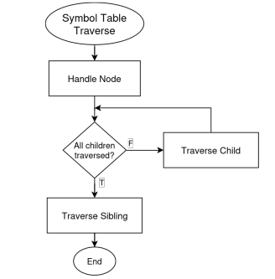
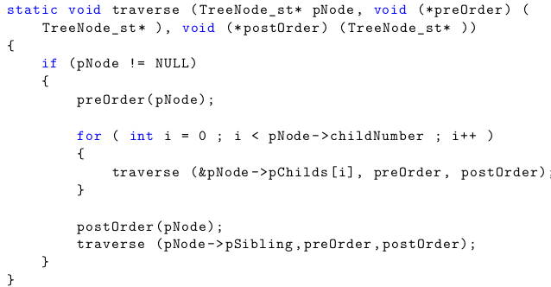
Semantic analysis
Symbol Table Traversal

Slide 20
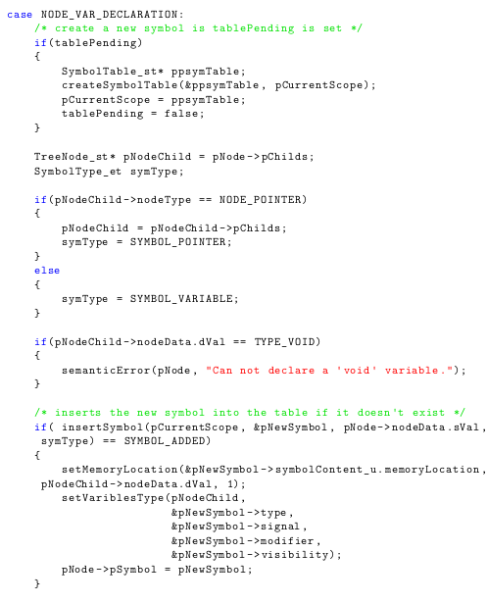
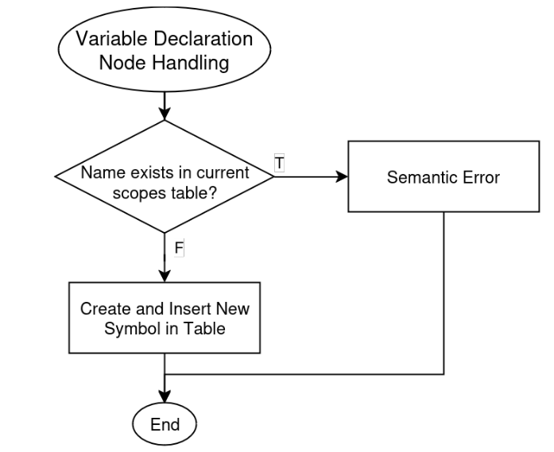
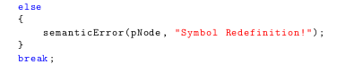
Semantic analysis
Node Processing and Symbol Table Management
Variable Declaration

Slide 21
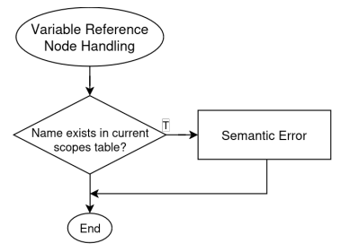
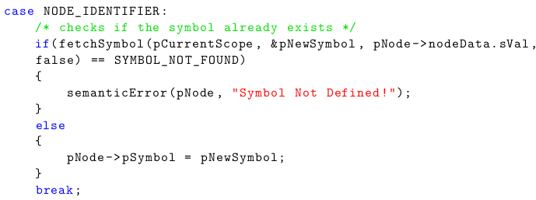
Semantic analysis
Node Processing and Symbol Table Management
Variable Reference
F
T

Slide 22
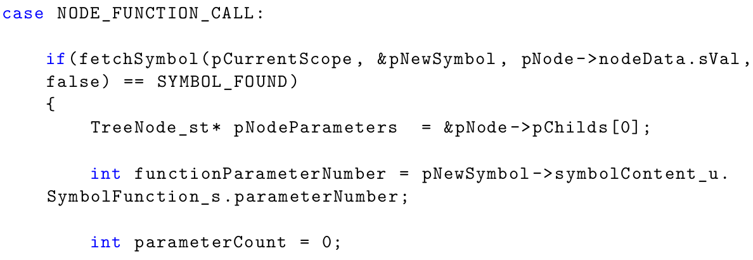
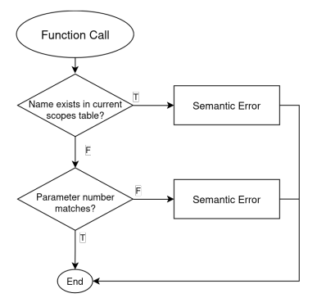
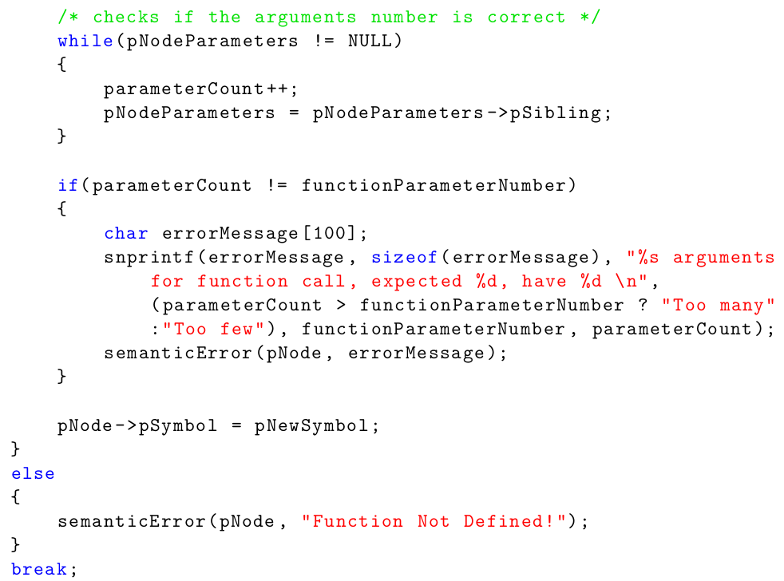
Semantic analysis
Node Processing and Symbol Table Management
Function Call
F
T

Slide 23
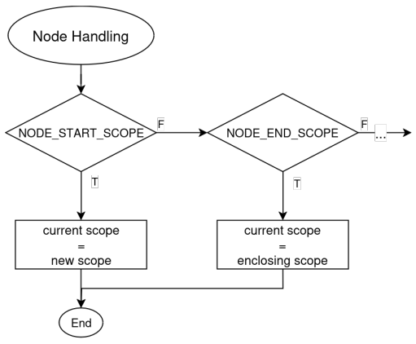
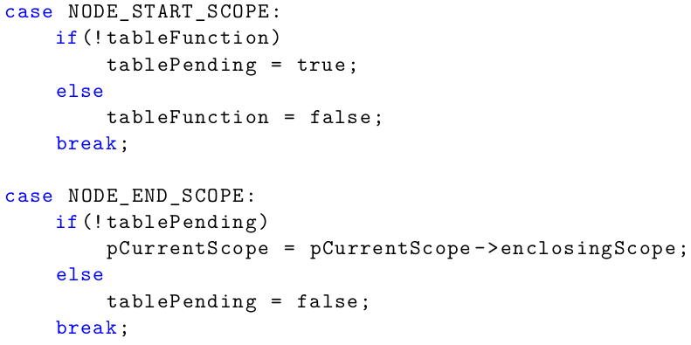
Semantic analysis
Node Processing and Symbol Table Management
Scope Handling

Slide 24
Semantic analysis
Strongly Typed C
• Array index must be INT, LONG or SHORT
• Inc and Dec operations can be executed on variables and pointers
• Case condition must be INT or CHAR
• Conditions of ternary operator, while, do while, if and switch can’t be STRING
• Operands of bitwise operations must be INT, CHAR, SHORT or LONG
• Division by zero is not allowed
• Assigning a pointer to a pointer is allowed
• Assigning an address of a variable to a pointer is allowed
• Assigning a STRING to a CHAR pointer is allowed
• Assigning an INT variable to a CHAR variable is allowed
• Pointer typecast is allowed (ex: int* ptr = (int*) 0x100)

Slide 25
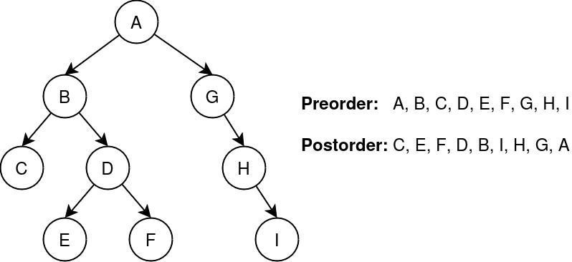
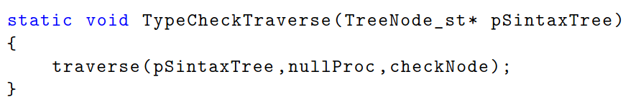
Semantic analysis
Type Checking Traversal

Slide 26
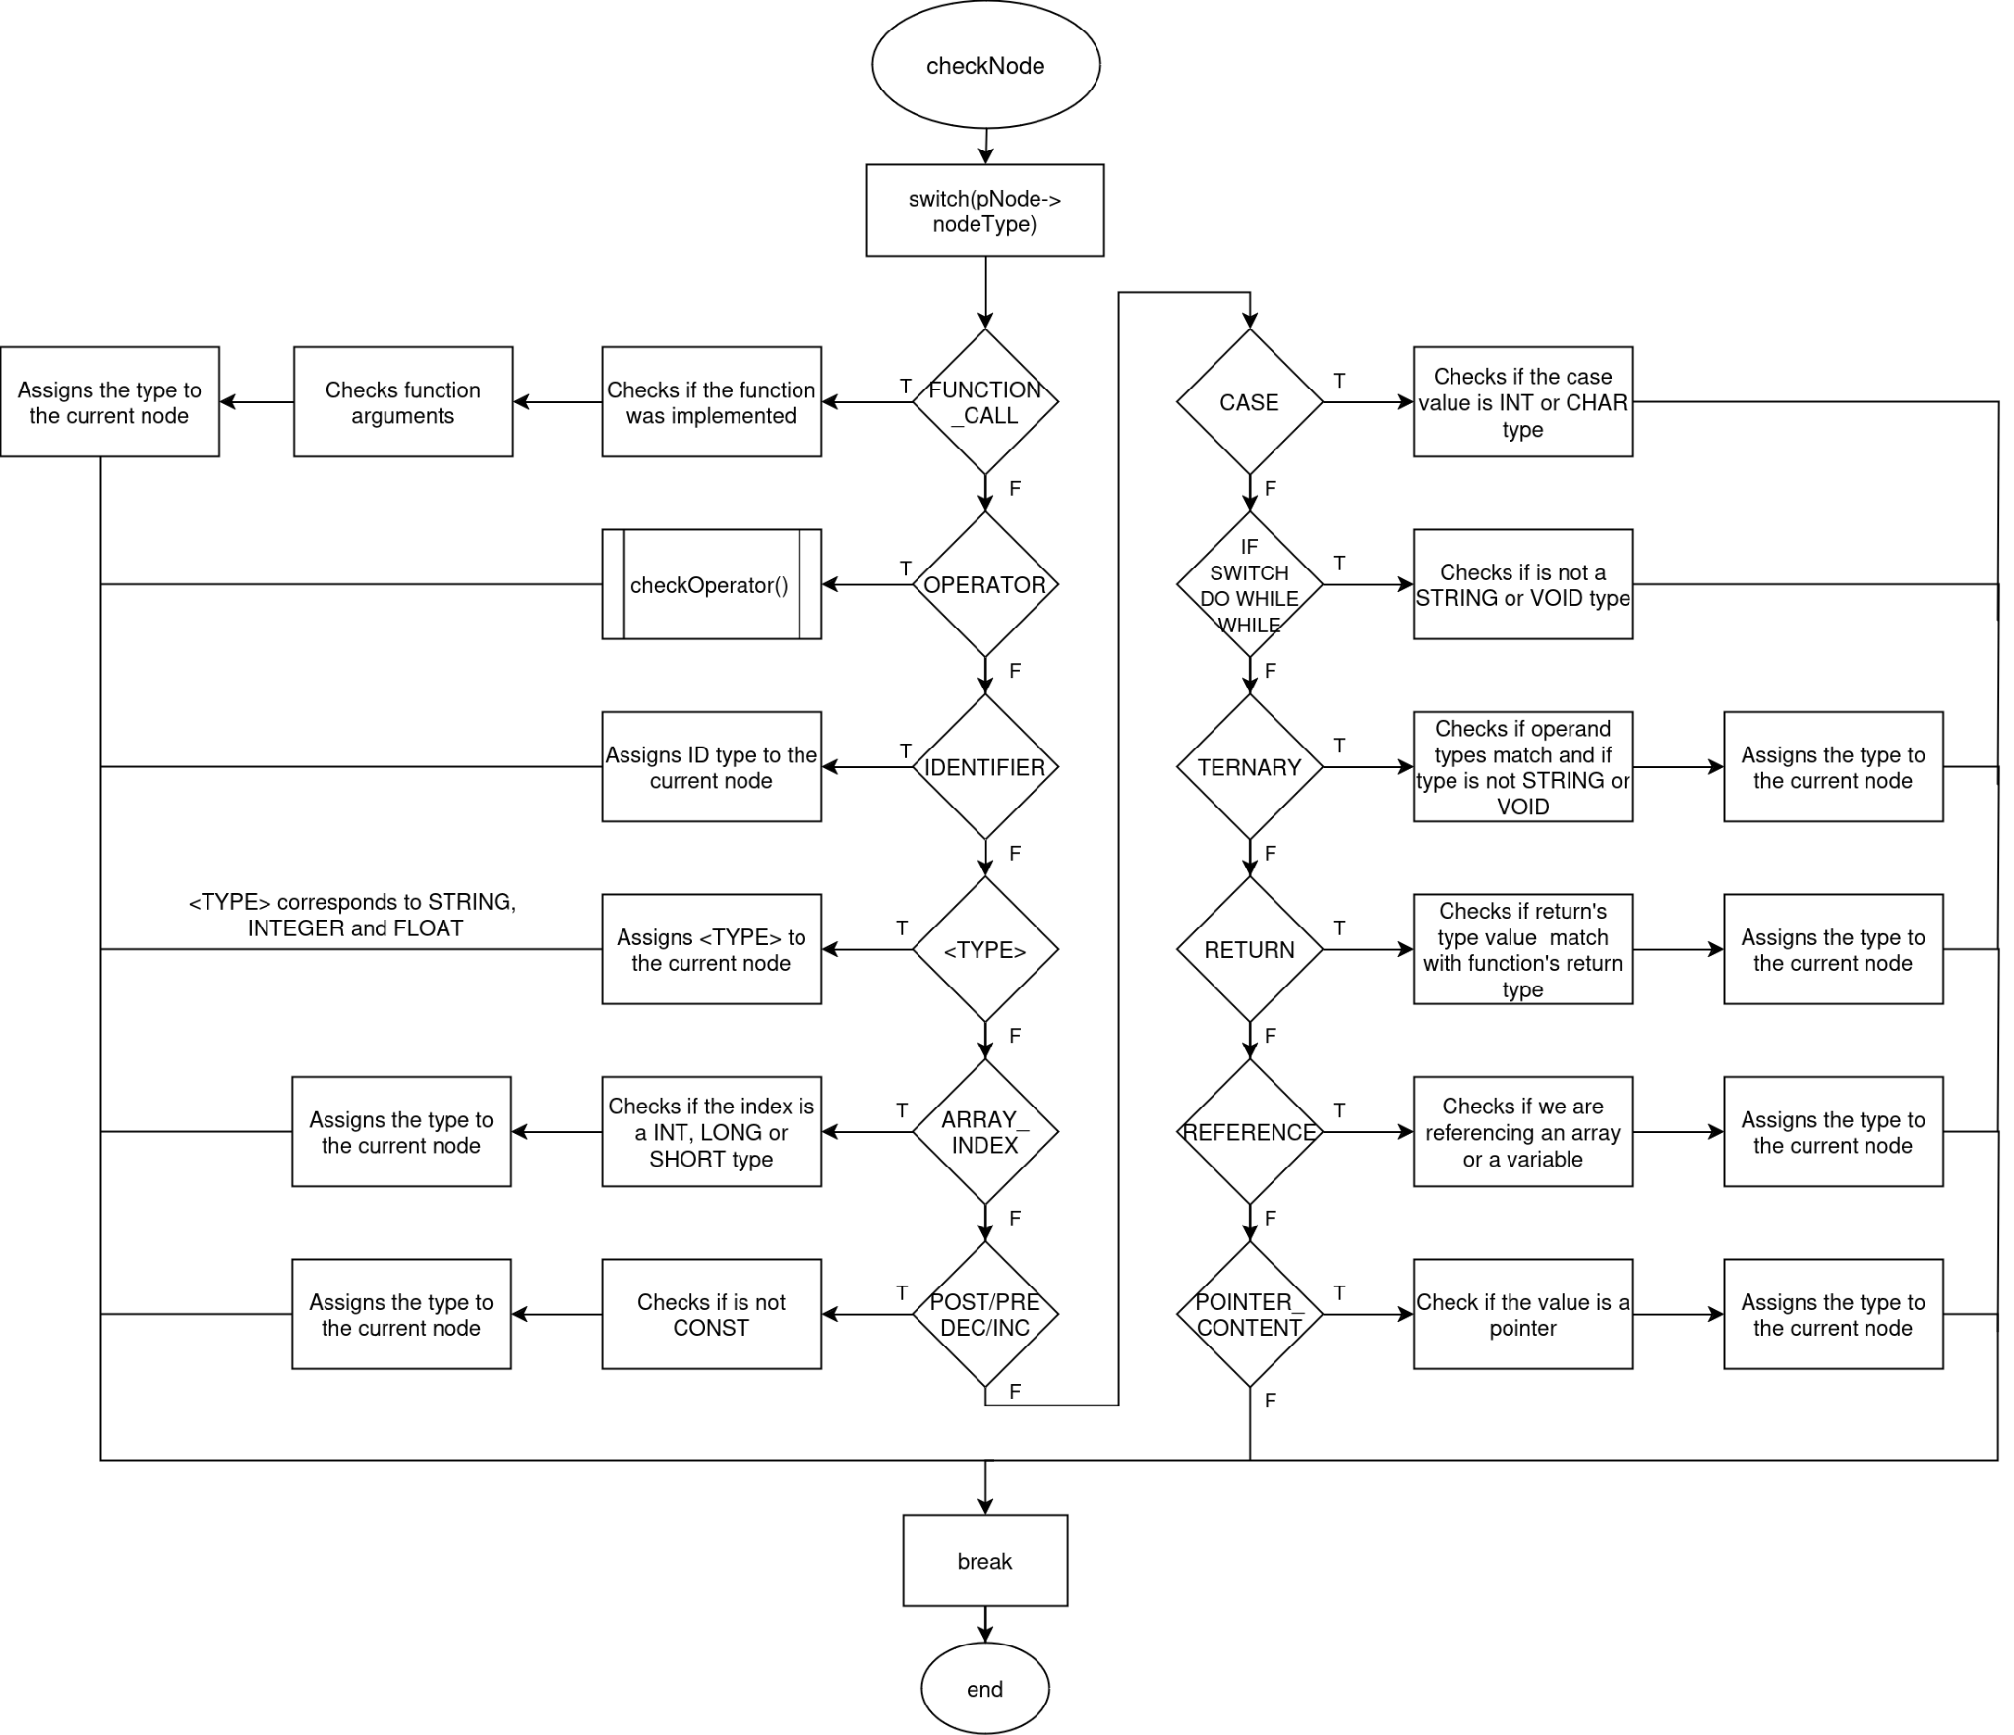
Semantic analysis
checkNode function fluxogram

Slide 27
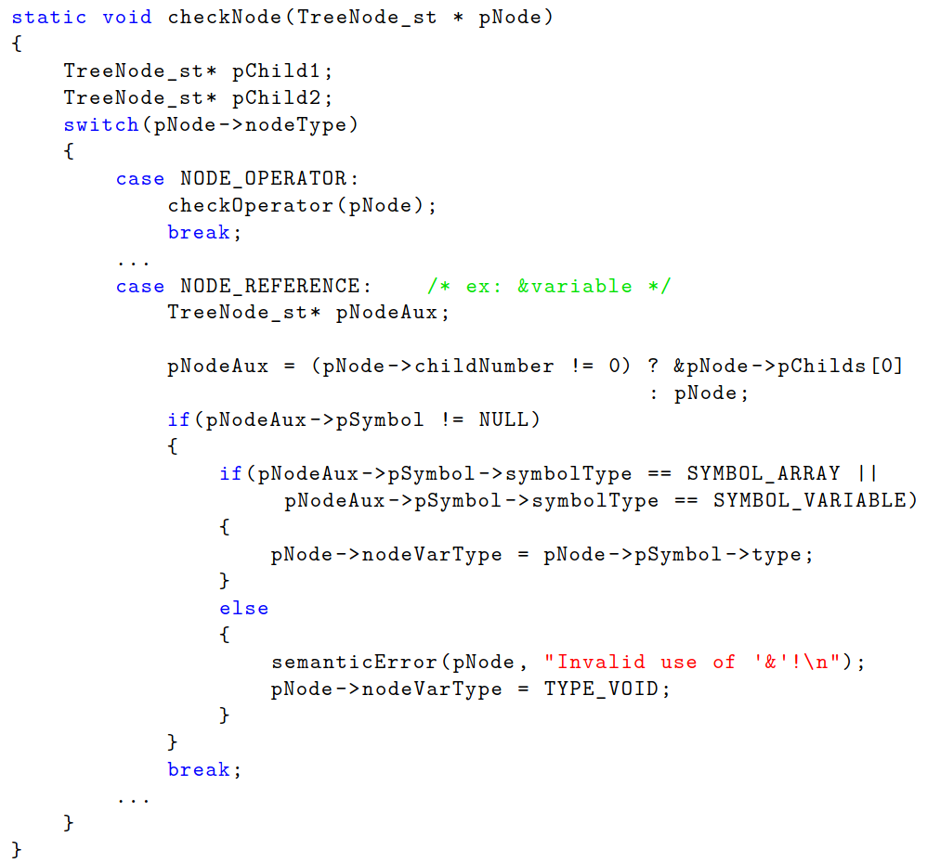
Semantic analysis
checkNode function implementation

Slide 28
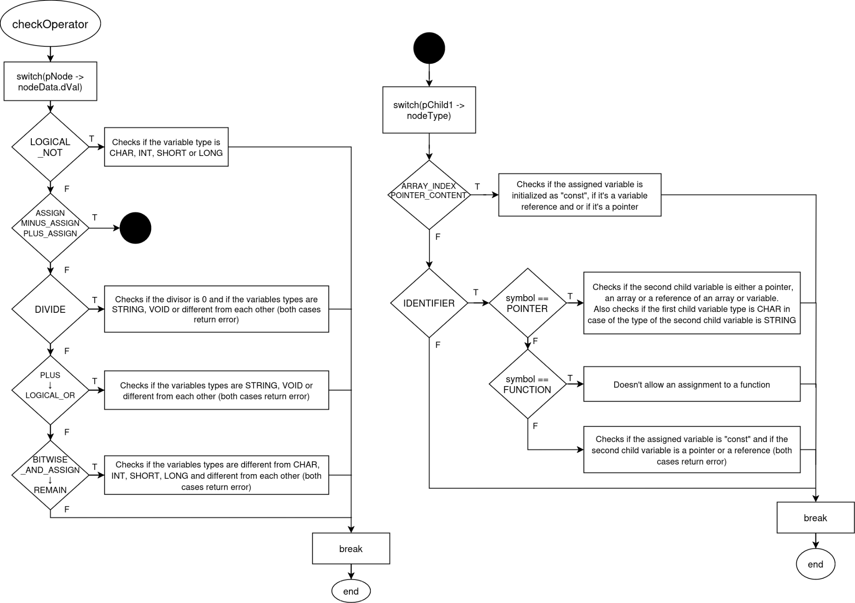
Semantic analysis
checkOperator function fluxogram

Slide 29
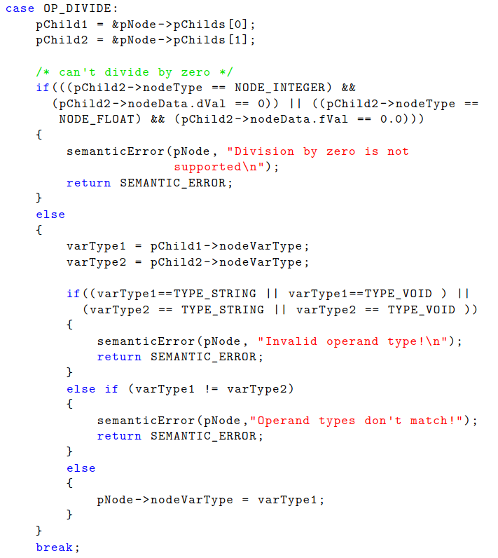
Semantic analysis
checkOperator function implementation

Slide 30
MIDDLE-END

Slide 31
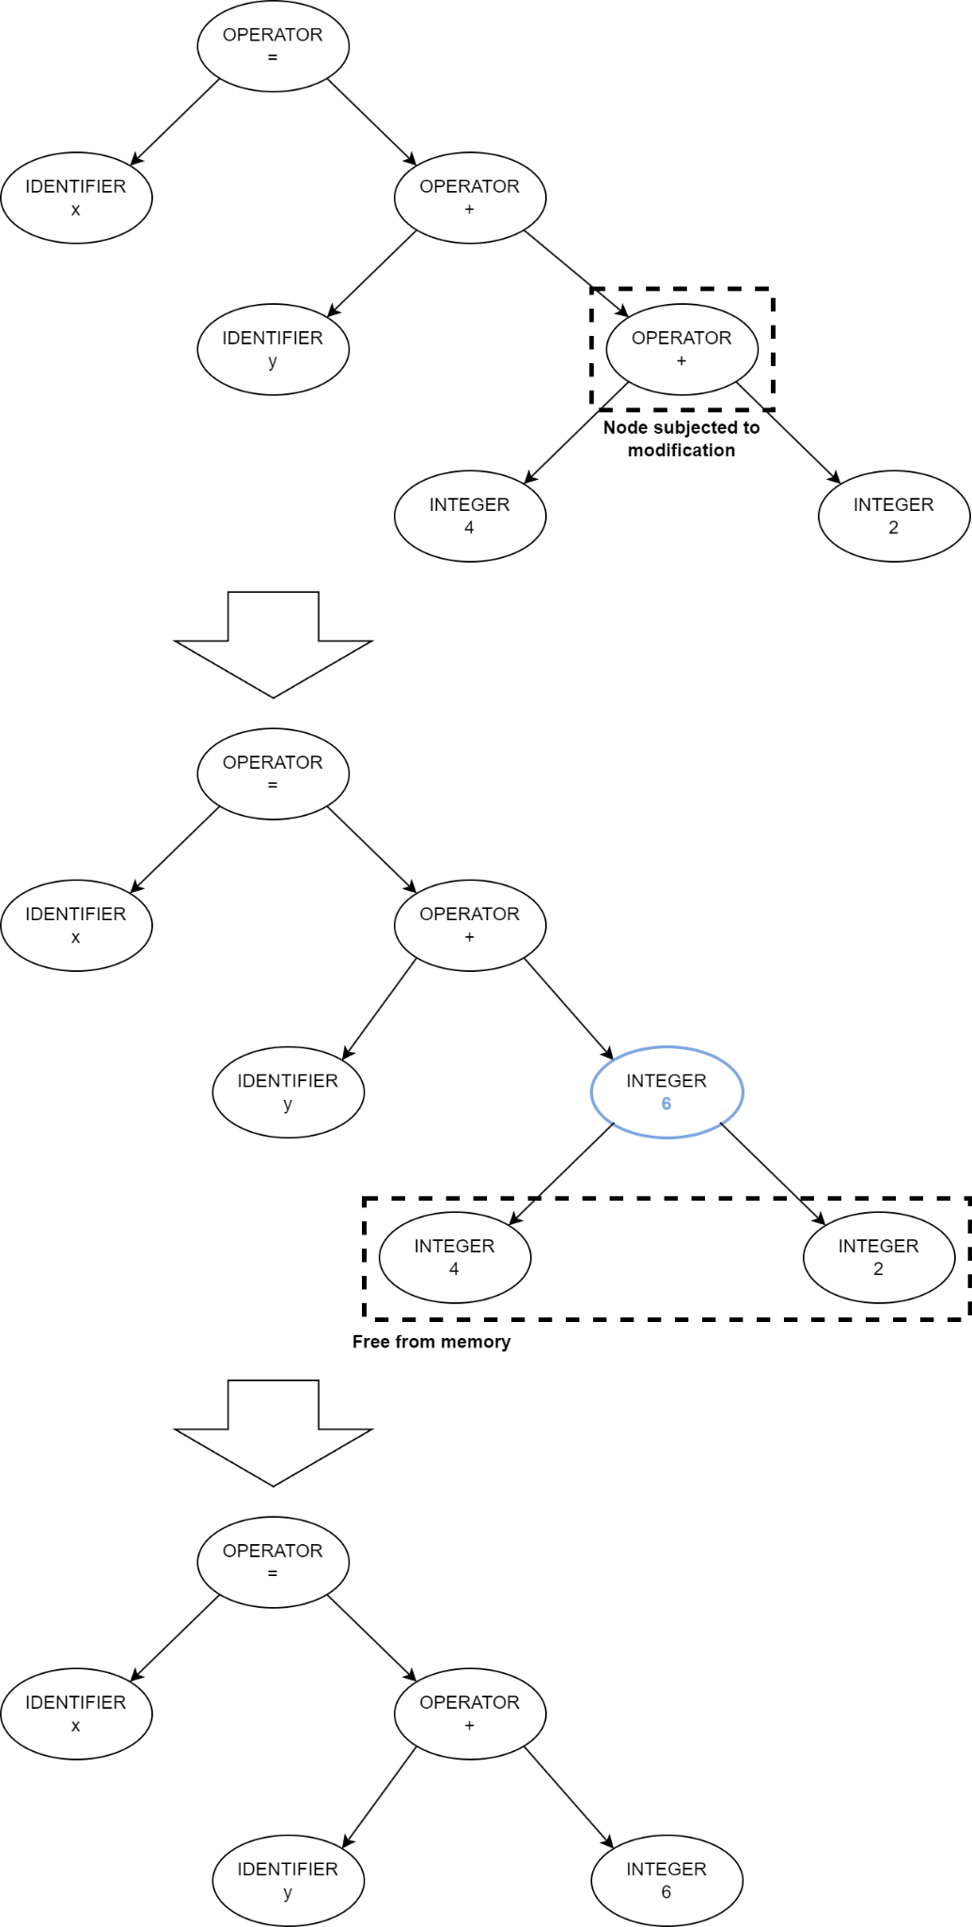

Constant Folding
Constant Folding Steps:
Search for operator nodes with constant value childs
Calculate operation value
Change node type, node value and nodes childs of the old operator node
Free the child memory space
Example:
x = y + 4 + 2
After constant folding optimization:
x = y + 6

Slide 32
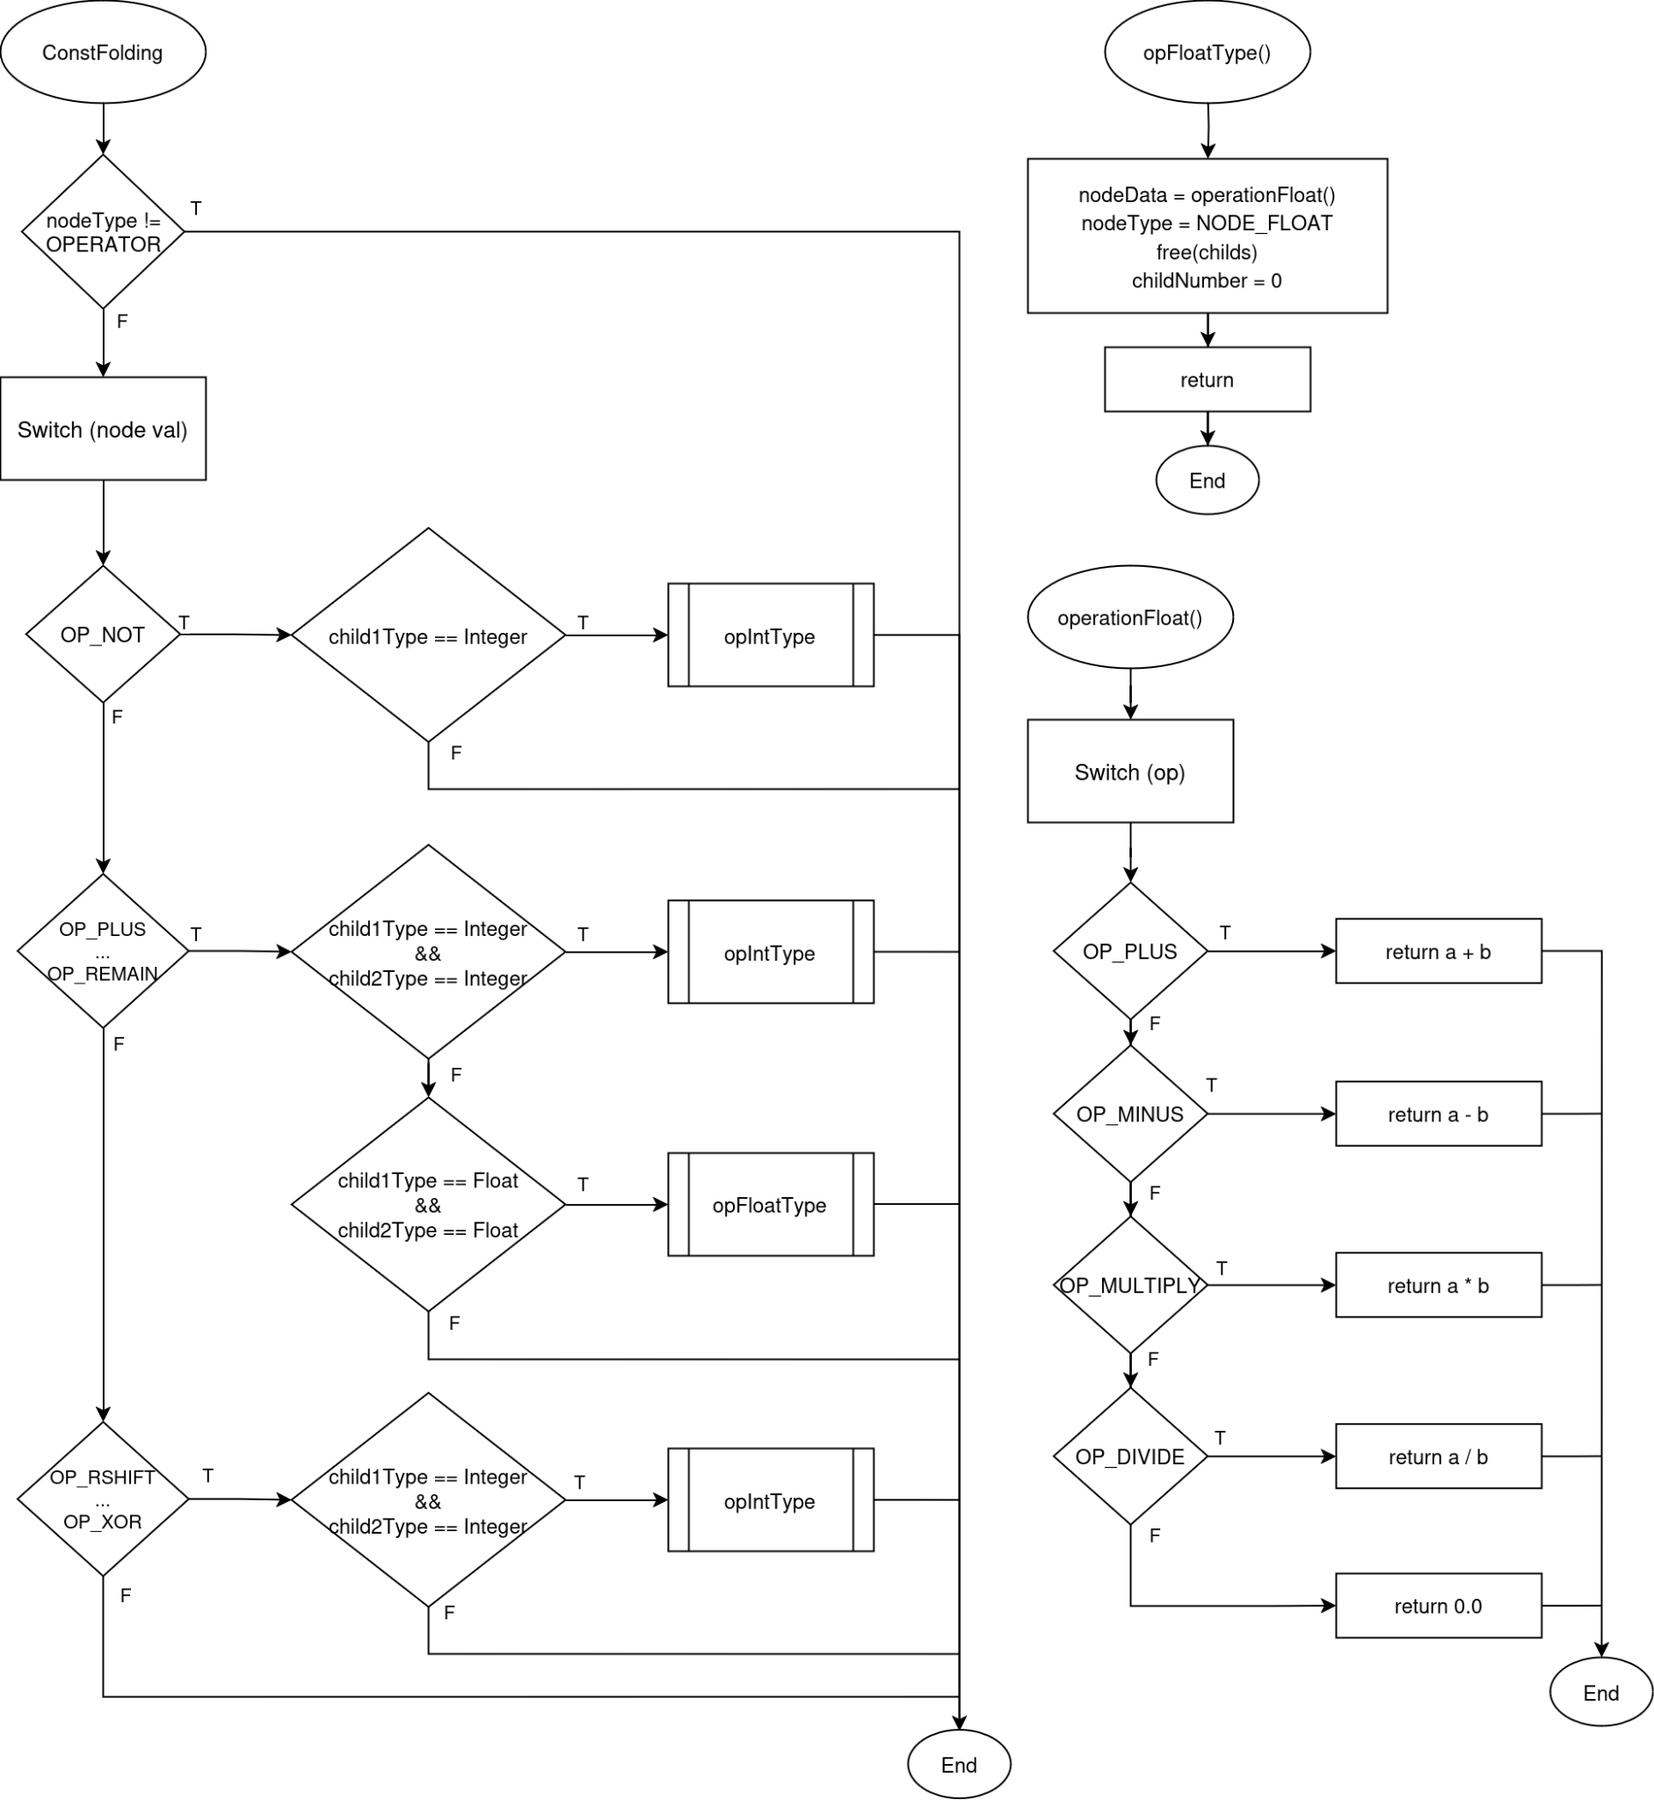
Constant Folding
Update:
node type,
node value
nodes childs
Free child memory
Calculation of operation Value
Child types Verification

Slide 33
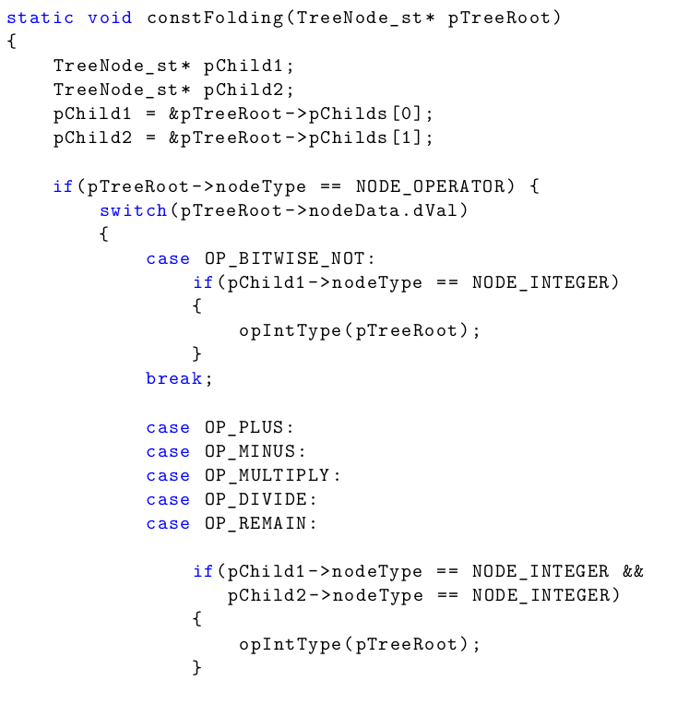
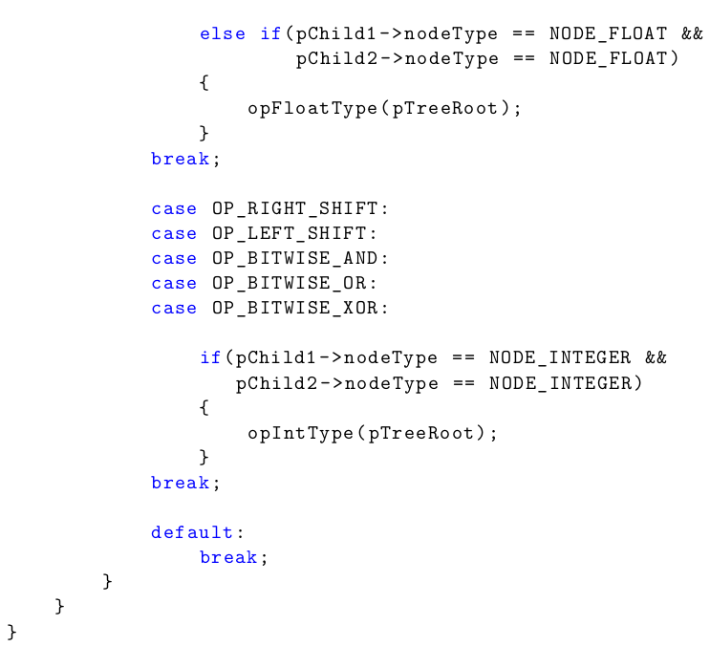
Constant Folding

Slide 34
BACKEND

Slide 35
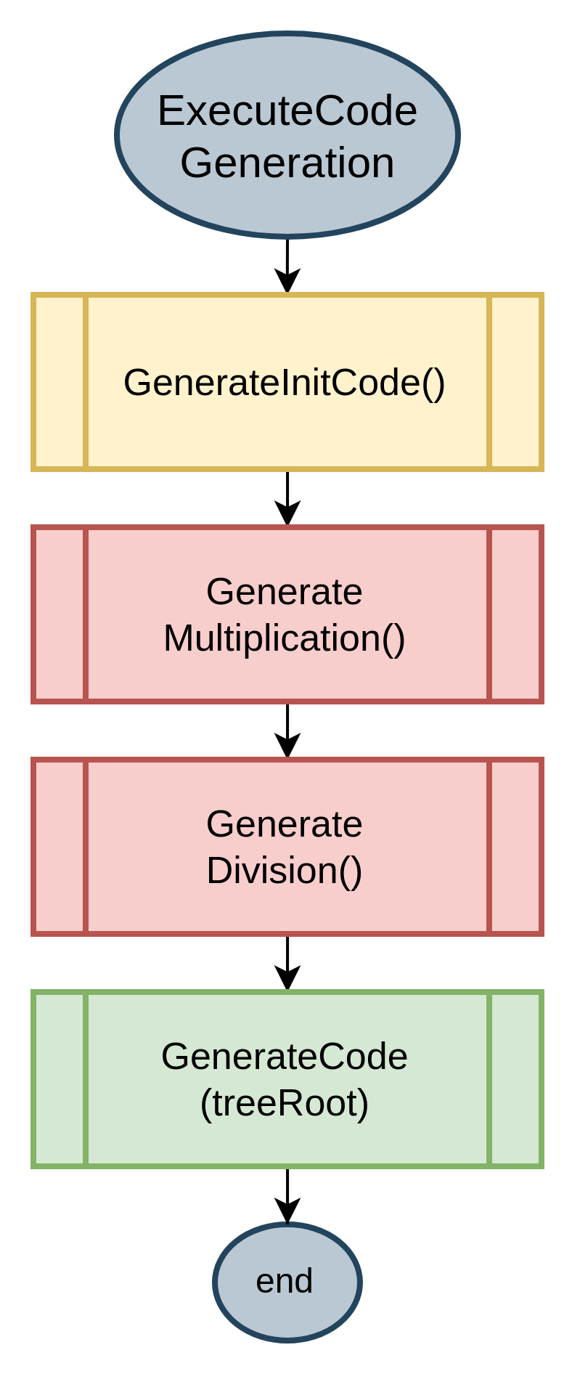
Code Generation
Compiler Code Generation phase:
Responsible for interpreting the created AST and generate assembly code
Generate Initialization Code
Generate Multiplication and Division Functions
Traverse the AST and generate code

Slide 36
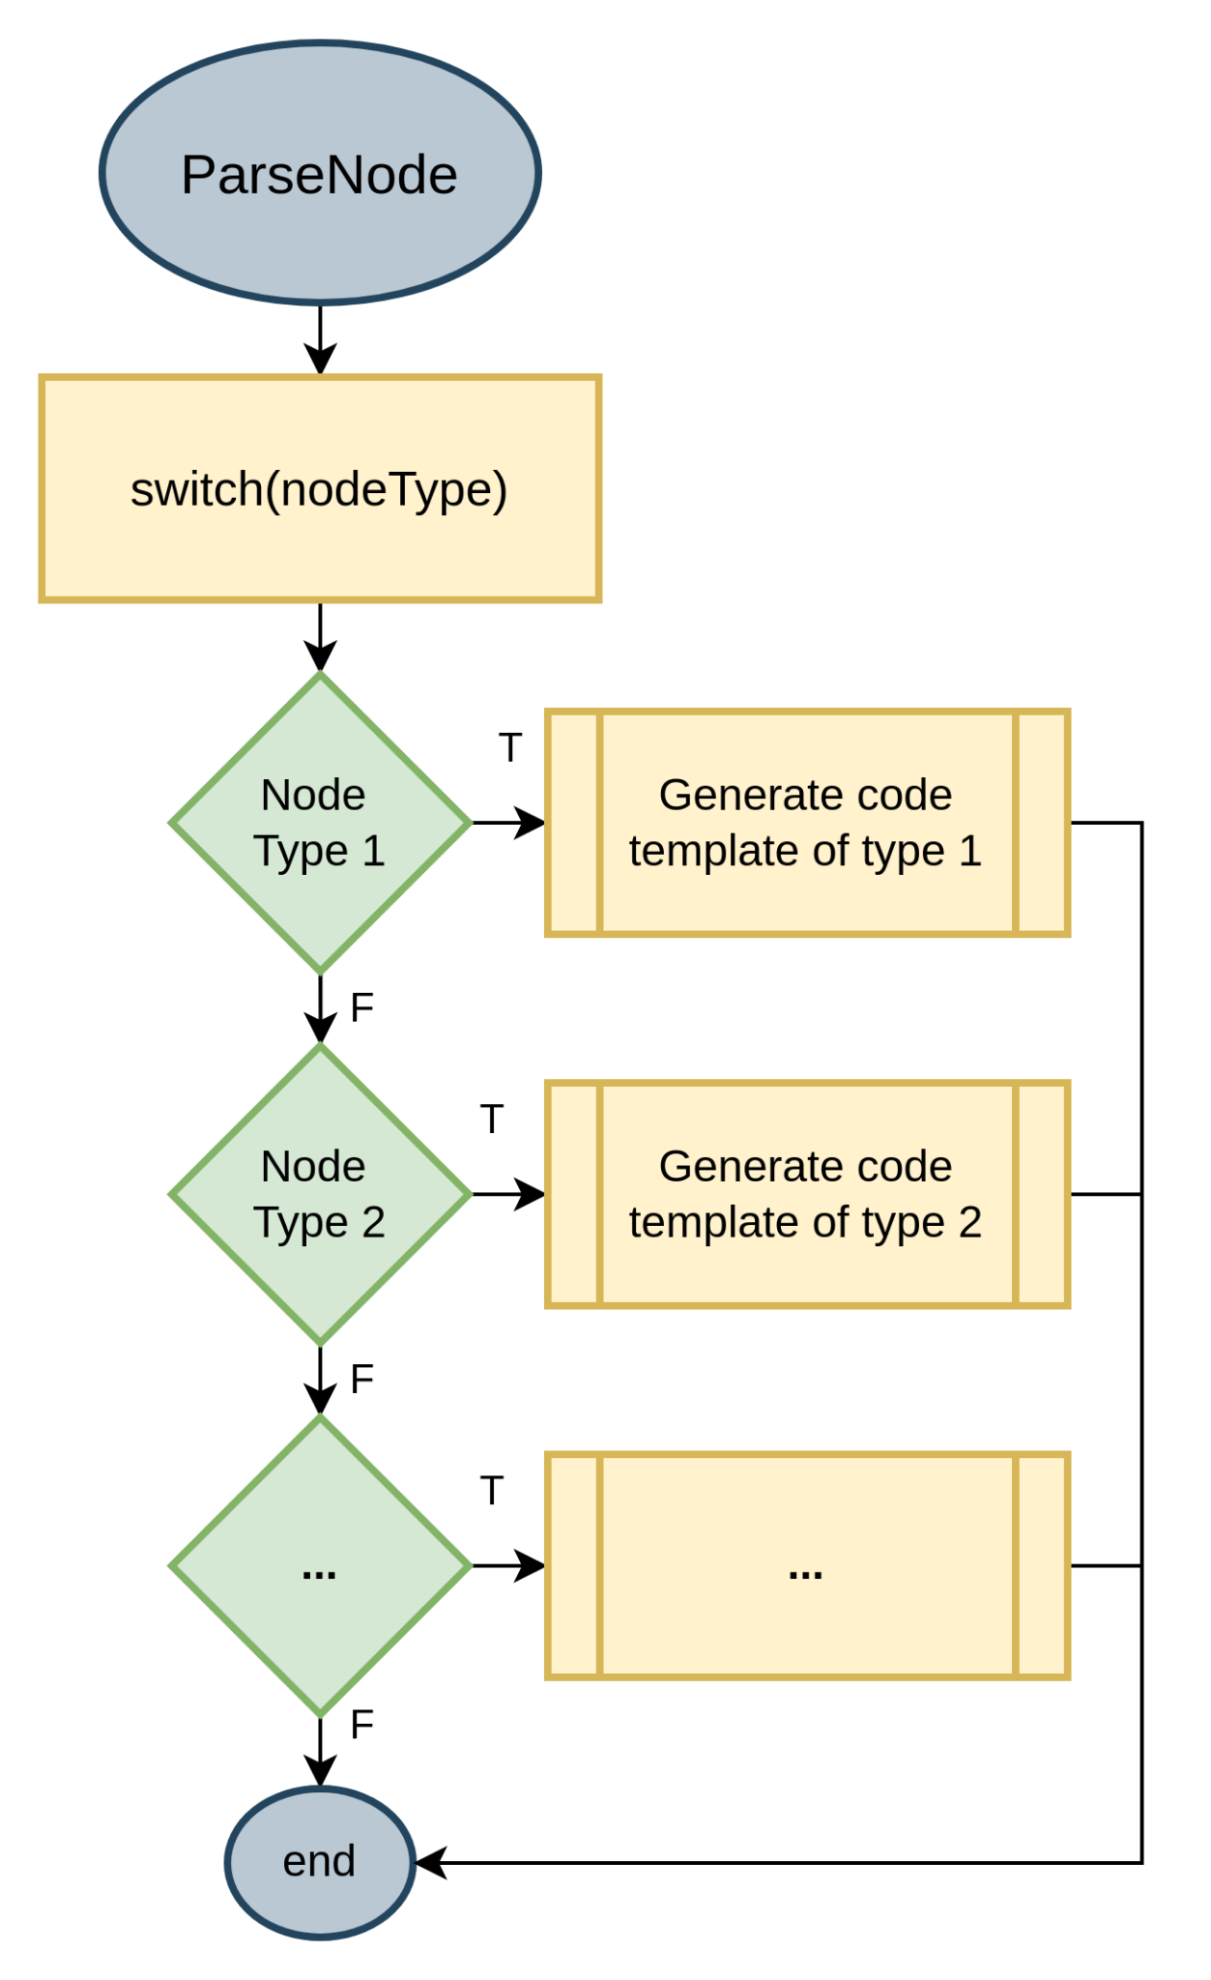
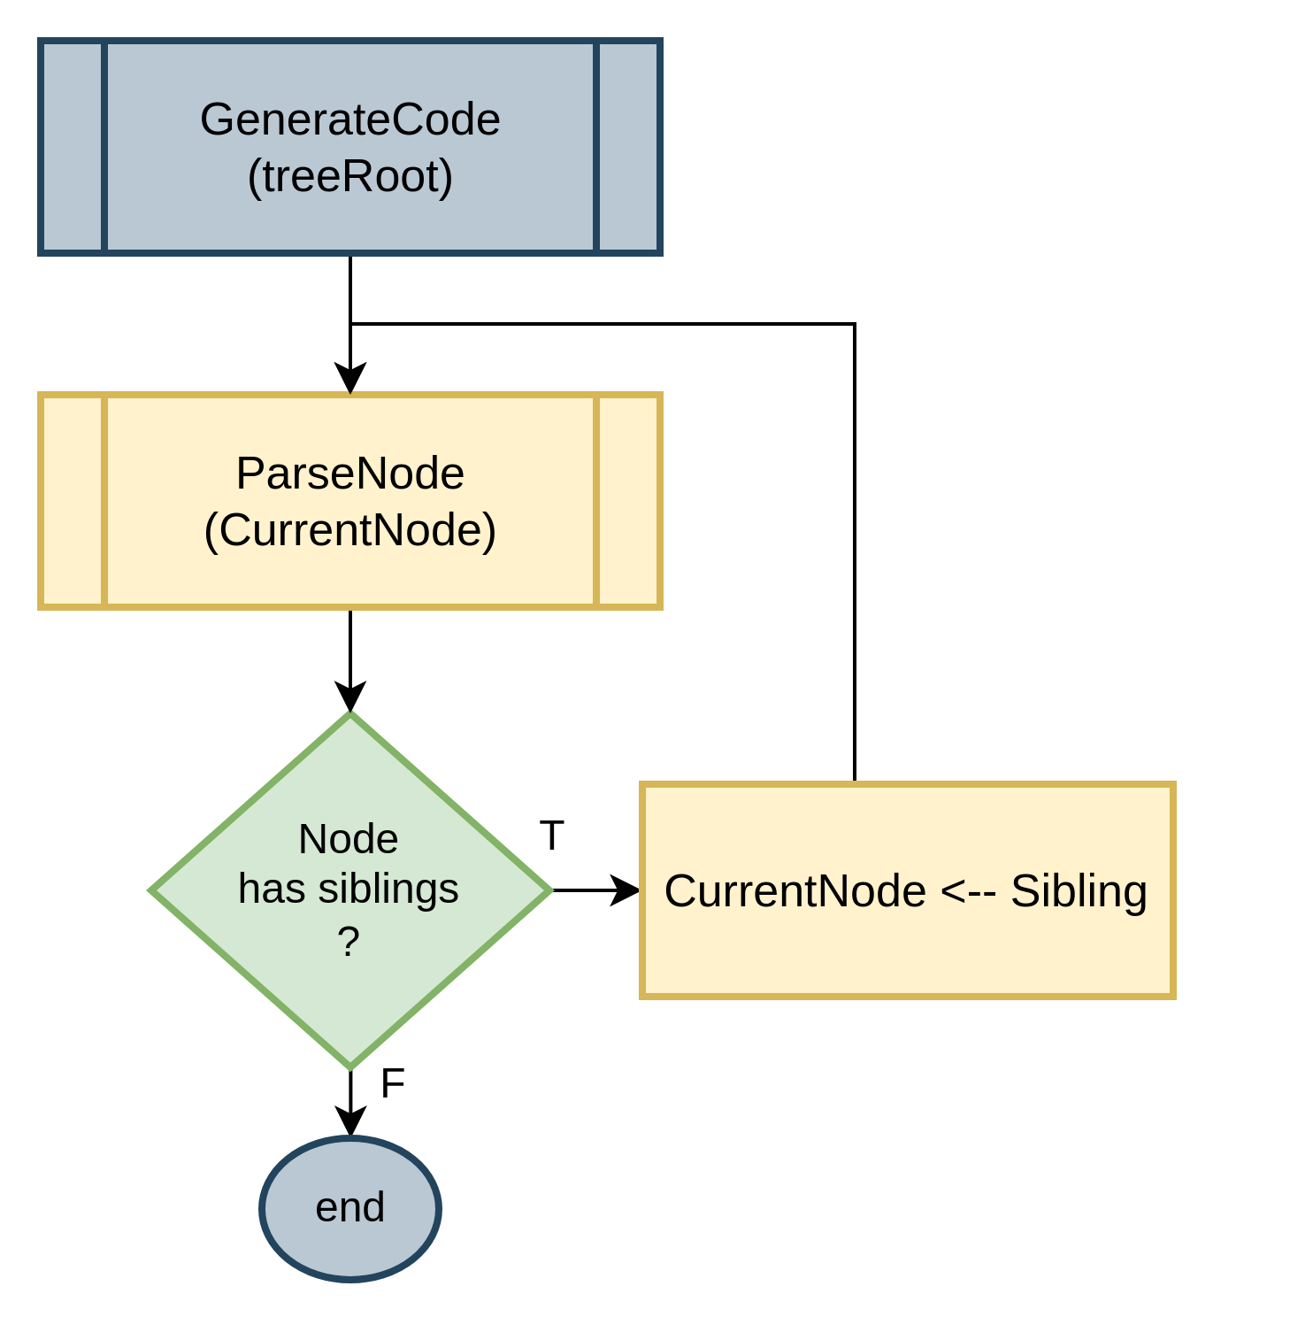
Code Generation
GenerateCode(): Parses each node and all its siblings
ParseNode(): Checks the node type and generates its template accordingly. Some nodes, mainly expressions, are handled recursively

Slide 37
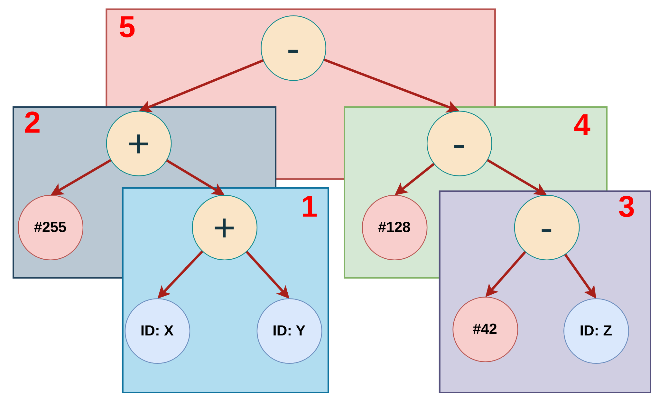
Code Generation
AST traverse when generating expressions:
Parse the root node
If both childs are terminals, the code is generated
If not then we parse the non terminal childs (left first)

Slide 38
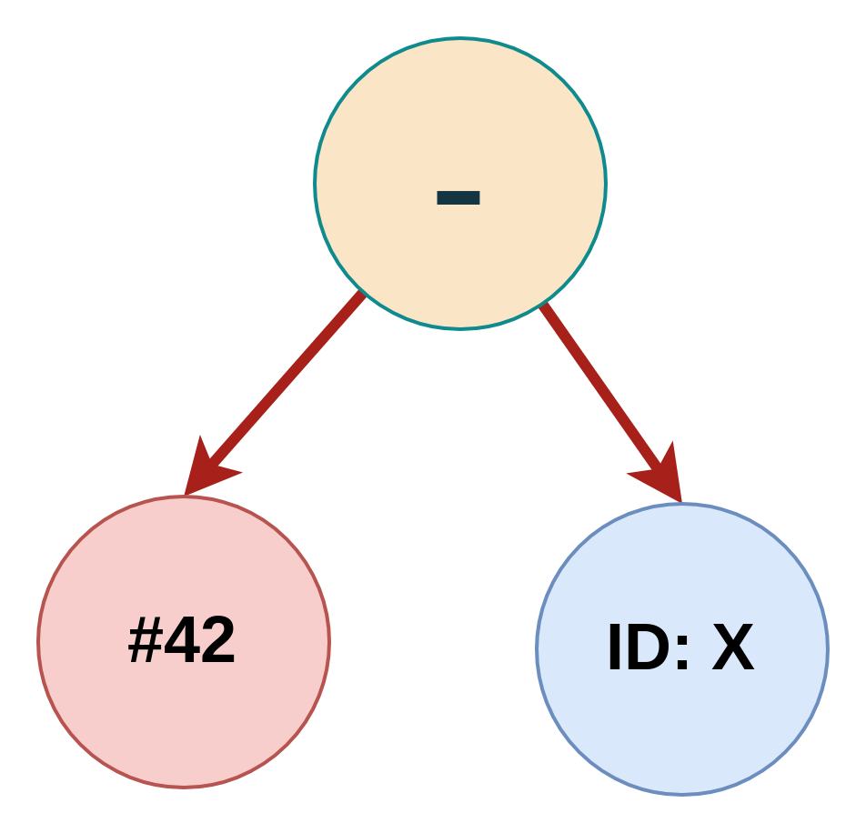


Code Generation
Handling Subtractions with immediates:
Operations with 2 immediates will not exist because we applied constant folding.
VeSPA ALU only allows immediate values on the right Operand.
Trees with an immediate left child are handled with an add instruction, by negating the immediate value and the result of the sum.

Slide 39


Code Generation
Code Templates
Boolean Operations
Designed to store their result as a 0 or a 1 in a output register;
Result register is preloaded with a 1;
Condition is checked through a pair of CMP and BRA instructions, which when taken, skips over a load that puts a 0 in the result register.
Relation Operators (==, !=, <, <=, >, >=)

Slide 40




Code Generation
Code Templates
Logical AND:
Logical OR:

Slide 41


Code Generation
Code Templates
Logical NOT:

Slide 42




Code Generation
Code Templates
IF:
While:

Slide 43




Code Generation
Code Templates
Do While:
Switch:

Slide 44
Code Generation - ABI
Register Calling Convention
Data types
All fundamental data types have the same size and alignment
The only composite data type supported is arrays
Bitfields
Packed in big-endian order
Register | Description | Caller Saved
R0 | Zero Register | -
R1 | Return Address | Yes
R2 | Frame Pointer | Yes
R3 | Stack Pointer | Yes
R4 - R5 | Return Register and Argument Passing | No
R6 - R31 | Temporary Registers | No

Slide 45

Code Generation - ABI
Parameter Passing
Parameters are passed through the stack, first argument starting at the first available space;
Return values are passed through register R4;
Exception made where parameters are passed through R4 and R5 to functions that perform multiplication and division.
Stack Management
Stack grows downwards;
The first argument passed onto the stack is located at offset given by the number of parameters plus two of the stack pointer on function entry.

Slide 46

Code Generation - ABI
Stack Frame
Each function has a stack frame;
Arguments accessible with positive offsets;
Local variables accessible with negative offsets.

Slide 47
Code Generation - ABI
Procedure Calling Convention
Push arguments to stack;
Save Frame Pointer and copy current Stack Pointer to it;
Save Return Address;
Jump to function using JMPL instruction with R1;
Execute function;
Copy Frame Pointer to Stack Pointer;
Restore program to where it was called using JMP;
Place result in return value register;
Restore previous Return Address;
Restore Frame Pointer
Free stack space occupied by function’s arguments.
Only registers R1, R2 and R3 are preserved across function calls.

Slide 48

Code Generation
Stack management
Performed by manipulating stack pointer (register R3);
To execute push and pop:
Push(Reg_x):
SUB R3, R3, #1
STX Reg_x, R3, #0
Pop(Reg_x):
LDX Reg_x, R3, #0
ADD R3, R3, #1
To allocate or free space on the stack, add or subtract the required spaces from the stack pointer.
Template for a variable declaration uses this method to allocate stack space for local variables.

Slide 49

Code Generation
Function Call
Creates the epilogue and prologue.
From the calling procedure:
Push arguments to stack;
Save Frame Pointer and copy current Stack Pointer to it;
Save Return Address;
Jump to function using JMPL instruction with R1;
…
Place result in return value register;
Restore previous Return Address;
Restore Frame Pointer
Free stack space occupied by function’s arguments.

Slide 50

Code Generation
Function and Return:
Function template checks if return is void, if it is emit the necessary instructions to exit the function code;
Otherwise, since the AST is valid, there must a return statement, and it will be the return template to generate the exit instructions.
From the calling procedure:
…
Execute function;
Copy Frame Pointer to Stack Pointer;
Restore program to where it was called using JMP;
…

Slide 51
Code Generation
Multiplication and Division/Modulus
Baseline VeSPA ISA does not support these operations;
Implemented as custom assembly functions;
Usage of operations result in a call to these.
Do not follow the procedure calling convention;
Parameter passing is done with register R4 and R5 with the first operand going into R4;
Returns values the same as other functions to R4, with the exception of Modulus operation which returns to R5 (Division and Modulus are performed with the same function at the same time);
Only functions that save the used temporary registers across calls.
Algorithms:
Multiplication: Shift add multiplication;
Division and Modulus: Restoring Division.

Slide 52

Code Generation
Initialization Code
Place a JMP at 0x00 to 0x40 where an initialization block is located;
Initialize the Stack Pointer (R2) and Frame Pointer (R3) to the top of the stack at 1023;
Preload Return Address (R1) with an address in which there is a halt instruction and push it to the stack;
This allows the program to stop execution when it finishes executing the main function;
Load a register with the label of main and jump to it.

Slide 53


Instruction Scheduler
(Retunning)
Due to VesPA architecture the only instructions that can be optimized are this specific case of the RAW hazard.
The way this hazard can be optimized is through instruction reordering.

Slide 54



Instruction Scheduler
(Retunning)
1.
Dependencies
2.
Control Instructions
3.
Corner Cases

Slide 55


Instruction Scheduler
(Retunning)
Dependencies:
To better explain the generic dependencies on VesPA:

Slide 56

Instruction Scheduler
(Retunning)
Full Dependency Analysis:

Slide 57

Instruction Scheduler
(Retunning)
Dependencies:

Slide 58



Instruction Scheduler
(Retunning)
2. Control Instructions:
JUMP
JUMP AND LINK
BRANCH
RET
RETI

Slide 59
Instruction Scheduler
(Retunning)
Corner Cases:
Branches and Double Stalls

Slide 60



Instruction Scheduler
(Retunning)
3. Branches:
Incorrect Assign of ALU Flags

Slide 61

Instruction Scheduler
(Retunning)
Double Stall:
Two stalls Can be Solved by one replacement

Slide 62

Instruction Scheduler
(Retunning)
Design:
Instruction Parsing
A simplistic ad-hoc parser was developed to read opcode and operands:
Each instruction is assigned attributes:
Mnemonic
Operand register number
Type
Line number
These attributes help check dependencies, detect potential stalls, and identify replacement positions.

Slide 63

Instruction Scheduler
(Retunning)
Design:
Code Blocks Division
As some instructions can never be used to replace a stall. To address this a separate block has been established for each group of instructions divided by the same instructions and directives
Conditions to divide code:
Conditional Branches:
concludes the current block, another can be initiated
Jump instructions, Labels or Halt
creates a new block

Slide 64



Instruction Scheduler
(Retunning)
Design:
Code Blocks Division
Each block will have its own set of instructions, as well as the stall and replace positions array.

Slide 65


Instruction Scheduler
(Retunning)
Design:
Stall Positions Verifications

Slide 66



Instruction Scheduler
(Retunning)
Design:
Replace Positions Checker

Slide 67

Instruction Scheduler
(Retunning)
Design:
File generation predicted Output
Initial Code
Optimized Code
Blue: Stall position
Purple: Instructions inbetween
Yellow: Replacement Instruction

Slide 68

Instruction Scheduler
(Retunning)
Design:
File generation Flowchart

Slide 69

Assembler
Step 1
Interprets assembly source code
Use the opcodes table
Produces symbols table and IR (statements list)
Step 2
Produces object code using the IR, the symbol table and the opcode table

Slide 70


Assembler
Lexical Analysis
A symbol is added when lexer detects an identifier token

Slide 71



Assembler
Lexical Analysis

Slide 72


Assembler
Syntactic Analysis

Slide 73


Assembler
Syntactic Analysis

Slide 74


Assembler
Code Generation

Slide 75


Assembler
Code Generation Implementation

Slide 76
VERIFICATION

Slide 77

Lexical Analysis
Token Parsing

Slide 78


Syntatic Analysis
Abstract Syntax Tree

Slide 79


Semantic Analysis
Symbol Table
Symbol table 0: Global scope
Symbol table 1: func1 scope
Symbol table 2: main scope

Slide 80

Semantic Analysis
Type checking
In case of no error found:

Slide 81


Constant Folding
Examples:
x = 2.7 + 1.4 + 3.2 + y + 2.0;
a = 3 + 4 × 5 + a + 2;
a = 3 + 6 / 3 + a + (2 − 1);

Slide 82


Instruction Scheduler
(Retunning)
Parsing Verification:

Slide 83

Instruction Scheduler
(Retunning)
Generic Solving:

Slide 84

Instruction Scheduler
(Retunning)
Dependencies:

Slide 85

Instruction Scheduler
(Retunning)
Dependencies:

Slide 86

Instruction Scheduler
(Retunning)
Branches:

Slide 87

Instruction Scheduler
(Retunning)
Eliminating Two Stall with One Replace Position:

Slide 88

Instruction Scheduler
(Retunning)
Avoiding Other Stall Generation:

Slide 89


Code Generation
Code Generated in function main

Slide 90

Code Generation
Code Generated in function main

Slide 91

Code Generation
Code Generated in function foo

Slide 92
Code Generation
Code Generated in function foo

Slide 93


Assembler
Token Parsing in Assembler

Slide 94


Assembler
Symbol Table and Intermediate Representation

Slide 95


Assembler
Code Generation in Hexadecimal and Conversion to Binary Code in .coe format
Hex File
COE File

Slide 96
Live Demo

Slide 97
Thank you for your attention !

